Slide 1
IIT-H

Slide 2
Why GNU radio?
There is a big gap from being able to use off-the-shelf SDR software and writing your own. After all, SDRs require lots of digital signal processing (DSP) at high speeds.
Not many people could build a modern PC from scratch, but nearly anyone can get a motherboard, some I/O cards, a power supply, and a case and put together a custom system. That’s the idea behind GNU Radio and SDR.
GNU Radio is a free software development toolkit that provides the signal processing runtime and processing blocks to implement software radios using readily-available, low-cost external RF hardware and commodity processors.
This is great for students!

Slide 3
Not good with Python? It’s ok!
There’s an even easier way to use GNU Radio: The GNU Radio Companion (GRC). GRC generates Python code for you!
This is a mostly graphical approach, allowing you to thread together modules graphically and build simple GUIs to control you new radio.
GRC has a signal generator block and interfaces to your sound card.
It even has the ability to read and write data to the file system, so you can use it to do many DSP applications or simulations with no additional hardware.
Open GNU radio and check out all the blocks! There is lot of open source support and documentation on every single block.

Slide 4
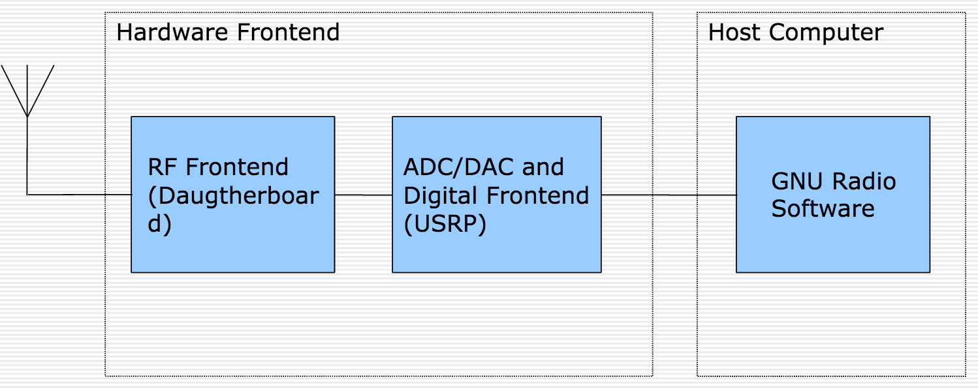
Components - nice and simple!

Slide 5
Decode NOAA signals using GNURadio

Slide 6
Introduction
LEO satellites are used to receive the NOAA signal. This is mainly due to the better image quality and also due to the fact that LEO satellites orbit from pole to pole, implying that they are bound to pass over a particular region at least twice a day. Their orbits are 840 kilometers in altitude and they circle the planet once every 104 minutes. The US National Oceanographic and Atmospheric Administration (NOAA) have both GEO and LEO satellites.
What do NOAA satellites send?
The satellite simply takes pictures and continuously transmits them towards the Earth.

Slide 7
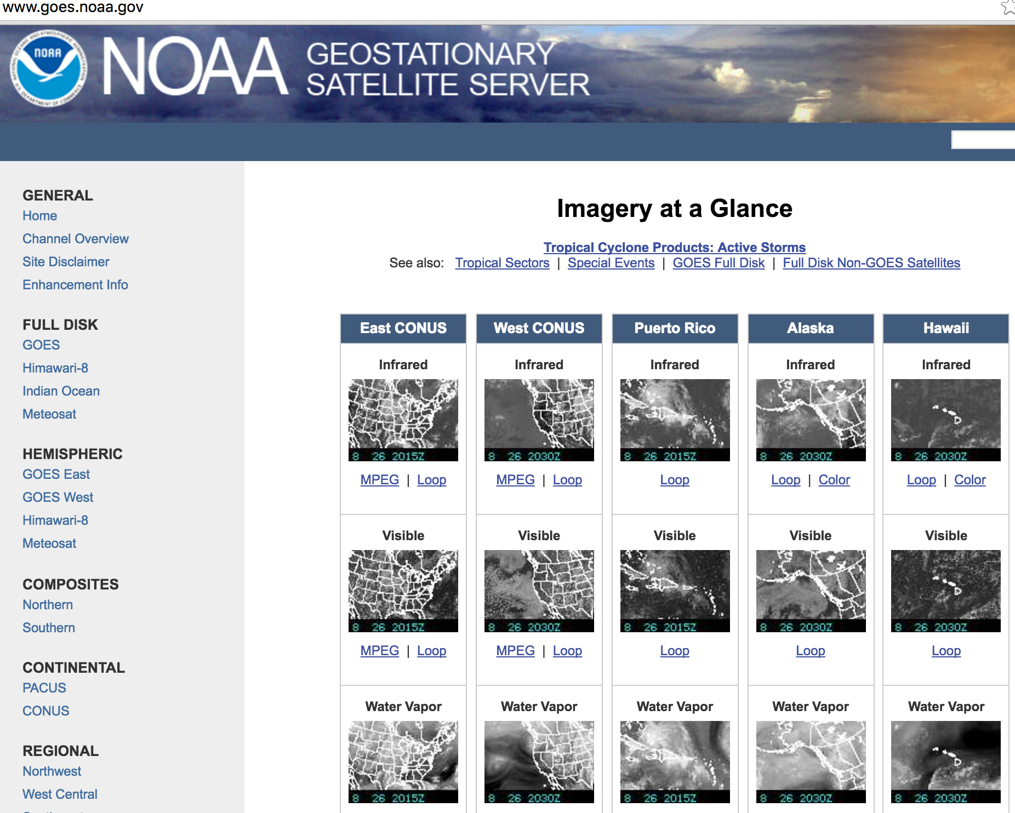
Lots of NOAA servers online

Slide 8
More details!
Currently, there are 4 operational NOAA satellites that orbit and send signals: NOAA-15, NOAA-17, NOAA-18 and NOAA-19.
The basic operation of the satellite is to use cameras that scan the visible spectrum as well as the infrared spectrum and take strips of images that would span approximately 3000 km. This image is then transmitted at 137 MHz right away and not stored on the satellite. This signal can be received through the antenna while the satellite is overhead, which can last up to 16 minutes.

Slide 9
Although, the signal can be detected for up to 16 minutes, it tends to be noisy for the first and last minutes. The best signal to noise ratio can be achieved when the satellite is directly overhead the antenna.
How do we track NOAA satellites?
NOAA satellites orbits the earth 24- hours and there exist plenty of different software that can be used to track the satellites. Also, there are free websites which provide tracking. There is a GNURadio Companion (GRC) file on github that can be used to record these signals.

Slide 10
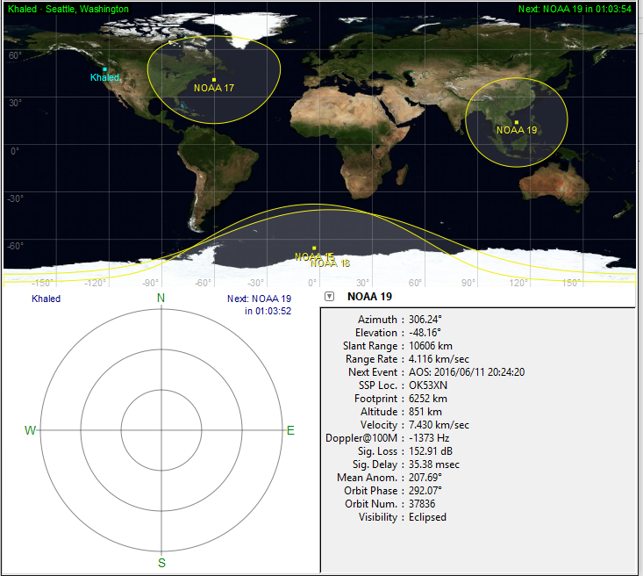
Main window of gpredict software used to track NOAA Satellite.

Slide 11
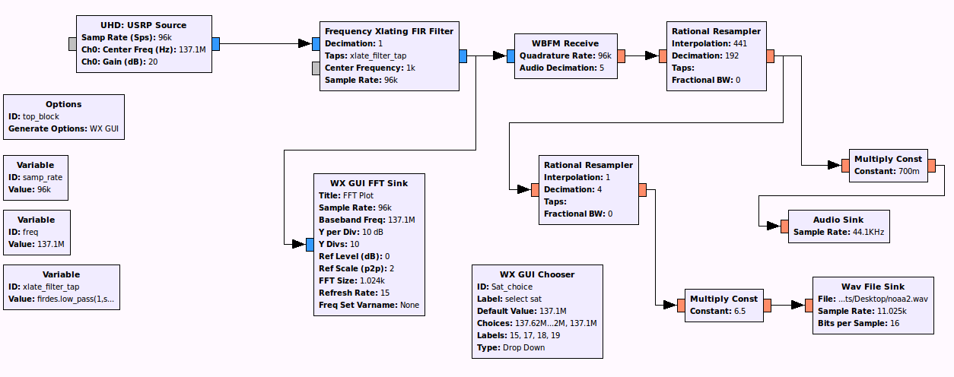
NOAA Satellite Receiver

Slide 12
Demodulation and display of images
Once the signal is received, the audio tones must be demodulated to represent varying levels of visible and inferred energy as processed by the satellite radiometer.
At the receiver, the satellite transmissions are detected as 2400 Hz AM modulated signal.
How can we demodulate AM signals? There are two ways this can be accomplished: using GNURADIO or using Python.
The Python file NOAA.py can be found on the Github repository.

Slide 13
Using GNU Radio to decode
For this project, we use the GNU Radio Companion tool. It provides a graphic model for assembling a set of signal processing modules.
Install GNU Radio and open GRC by typing ‘gnuradio-companion’ on the terminal.
What do we know from the recorded NOAA files?
Decoding process - After recording the satellite signal, the recorded wav file itself is an AM modulated signal. The AM subcarrier on 2400 Hz modulates image data, as amplitude variation along a gray scale. Each word is sampled using 8 bits/pixel along one row, which lasts exactly 0.5 seconds. The sampling rate of the recorded wav file is 11025 Hz.

Slide 14
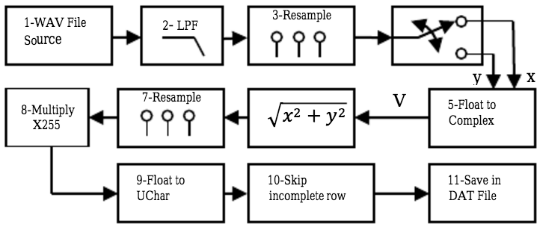
At this point, read the research paper at https://www.researchgate.net/publication/247957486_NOAA_Signal_Decoding_And_Image_Processing_Using_GNU-Radio to get a complete understanding.
Try to explore GNU Radio and build the system shown below (taken from research paper).

Slide 15
The following blocks can be found on GRC to construct the decoder.
WAV file source: On GRC, find this block and choose ‘090729 1428 noaa-18.wav’ as the file – this is a recorded file that can be found on github. Under ’Repeat’ option, select No.
LOW PASS Filter: The recorded wave file is first passed through a low pass filter to remove the higher frequency components that could affect the quality of the decided image. The cutoff frequency is chosen such that it would pass the components around 2.4 KHz, the carrier frequency. [Decimation = 1, Gain = 1, Sample rate = 11025, Cut-off frequency = 4200, Transition width = 200]

Slide 16
Rational Resampler 1: After that, rational resampler block is used to resample the filtered signal to 9.6 KHz. The 9.6 KHz signal represents four samples for each word of the AM 2.4 KHz signal. Therefore, we have four samples/period and the samples come with 90-degree phase shift. [Interpolation = 9600, Decimation = 11025]
Note: Connect two WX GUI FFT Sink blocks at the input and output of the low pass filter to visualize the operation in real-time.
Float to Complex, skip head, Keep 1 in N: Using two consecutive samples we can detect the instantaneous amplitude of the AM 2.4 KHz signal at a rate of 4.8 KHz. The amplitude will be A = sqrt (x² + y²), if every pair of two consecutive samples is converted to a complex number V = x + iy, where x and y are float variables. The real and imaginary parts are interleaved as float variables in the signal, use Skip Head and Keep 1 in N blocks to obtain these parts. This will be fed to the Complex to Mag block.

Slide 17
Complex to Mag: The block Complex to Magnitude acts like an AM demodulator and thus the signal caring the useful data about the image is present at the output of the block.
Rational Resampler 2: The demodulated signal is not yet ready for saving because the true symbol rate in APT format is 4.16 KHz. The second ration resampler is used to resample it to 4.16 KHz. [Interpolation = 4160, Decimation = 4800]
Multiply constant: This block is used to expand the range of the signal between 0 and 255 to make it ready for saving. This range happens to be equal to the number we can render using eight bits. [Constant = 255]

Slide 18
Float to UCHar: This block is used to convert float numbers to unsigned char which is appropriate for saving the data file at the end.
Skip head: To skip the first row of the data which is usually not a complete row. [Num items = 1750]
File Sink: Finally, the signal is saved as is, in a .dat file, by this last block.
[Github instruction - The .dat file must be converted to png format to view the image. This can be done on the terminal via
convert -size 2080x1024 -depth 8 gray:output.dat output.png]
Now you can use this to decode live images over Hyderabad!

Slide 19
NOAA decoder using GNU radio

Slide 20
Designing an FM receiver using GNU radio

Slide 21
Now that you have used GNU radio, you must be able to design an FM receiver on your own!
Try using the fm_receiver.pyc on github. Is it noisy? The objective is to design a good FM receiver.
What do you need to know about FM signals?
Read up - http://www.arrl.org/files/file/Technology/tis/info/pdf/8506025.pdf

Slide 22
Search online about the basics –
What is VHF? What is the frequency range of FM signals? Will the daughterboard on the USRP be capable of tuning to this range?
Bandwidth of FM channels – What is narrowband FM? What is wideband FM? Where are they used?
Now, you need a ‘USRP source’ block on GNU radio. What is its center frequency and sampling rate? If WBX daughterboard is being used, the ‘Ch0: Antenna’ port should be set to “RX2” or “TX/RX”. This is physically written on the daughterboard (check!)

Slide 23
What are the ‘FM receive’ blocks in GNU radio? Based on narrowband and wideband FM, what should be the rate of samples being passed to the FM block?
How do we resample the signal from the USRP to the FM block?
The PC speakers require 48k sample rate – this is usually a default rate that sound cards use. Choose the Audio Sink block for this. Set ‘OK to Block’ to No. ‘Device Name’ can be blank.

Slide 24
After answering the above questions and setting up an FM receiver - is it still noisy? What is the gain of the USRP block? Should there be a low pass filter included?
Once you are satisfied with your FM receiver, can you rig up an AM receiver?!

